Slide 1
Covid-19 Analysis
Delta6
Oscar G, Edwin C, Jordi I, Thuvarakan N, Joseph K

Slide 2
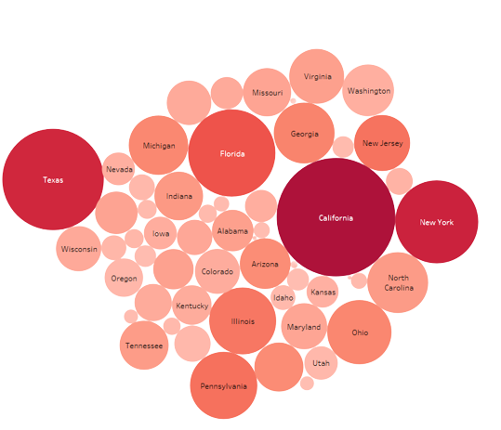
Analytical Objectives
Most things in the world can be expressed with enough data and being able to analyze large amounts of it can help us in everyday life.
Large Datasets:
The World Data Centre for Climate
National Energy Research Scientific Computing Center
Google
CDC
Library of Congress
Population vs Cases

Slide 3








Tools Used

Slide 4
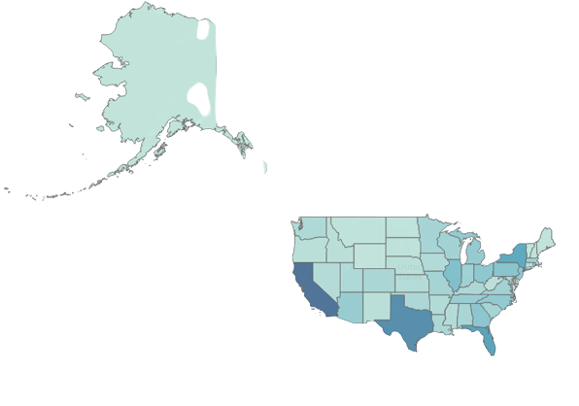
Total Division By Region US
Combined cases by each state.
Starts as simple query to divide given points.
Map:
Basic Division
Total Cases
Total cases per state as of 5/2/2021

Slide 5
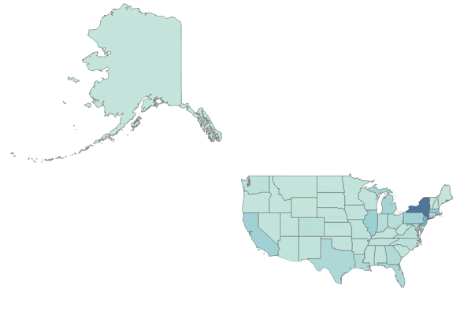
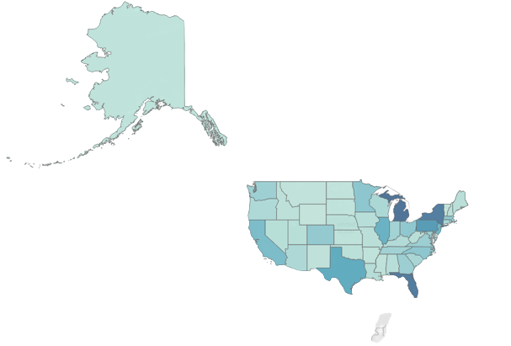
Monthly New Cases US
Each month was taken from the start until the last day.
April cases spiked
One Year difference
Common Traits:
Population
Tourism
Travel
International Businesses
April 2020
April 2021

Slide 6
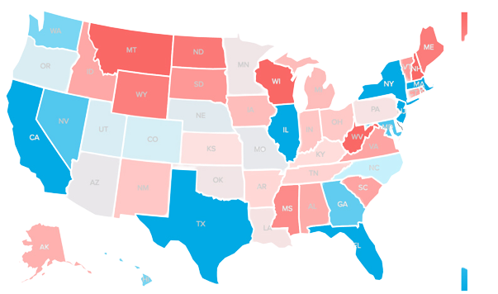
Most International Travelers
Most Travelers April 2020
Travel and early pandemic cases appear to be correlated.
Nevada is an exceptions

Slide 7
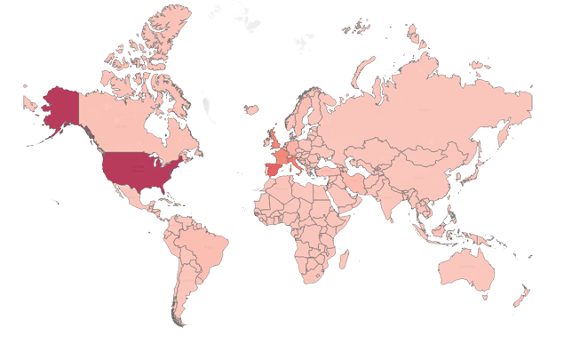
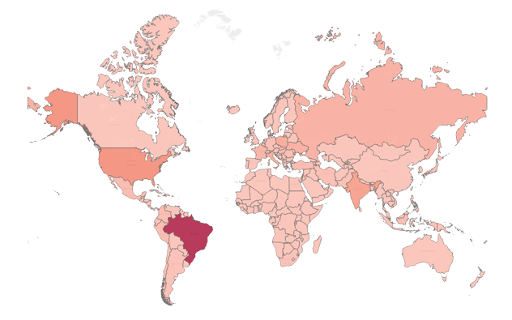
Daily New Deaths Worldwide
High travel rates:
USA
Spain
France
April 1st 2020
High Population:
Brazil
India
USA
Exceptions: Under Reporting
April 1st 2021

Slide 8
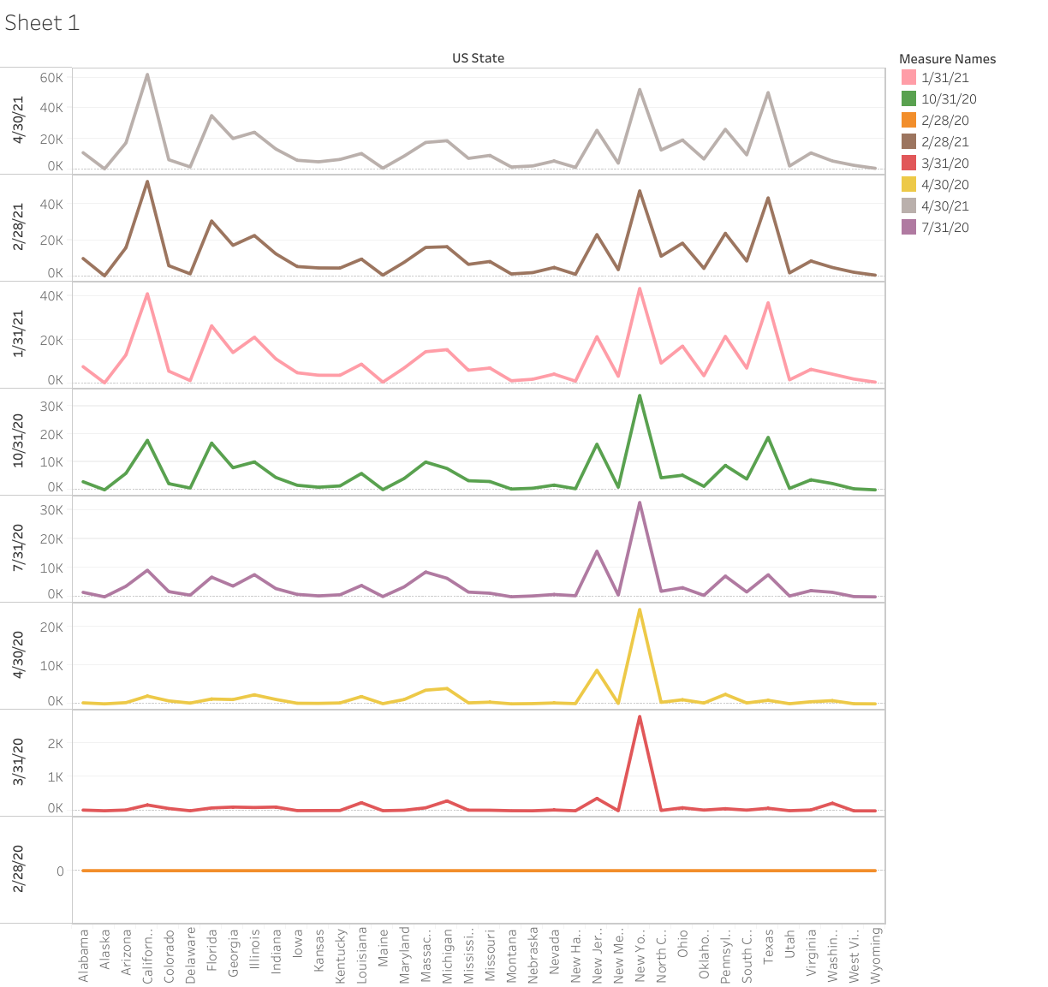
Total Death for each Month - USA
This query looked at the 50 US states and showed the number of Total deaths each month from the 2020 January to 2021 April
This line chart describe how increase Deaths in USA by States
California , New York and Texas has most Deaths in this Pandemic

Slide 9
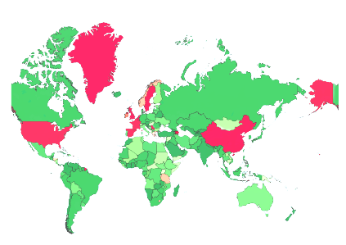
Recover Percentage Countries VS Population
This Query Load the Percentage of Recovery from Covid19 against respective Countries Population
Red Color represent the Bad Recovery percentage in Globally

Slide 10
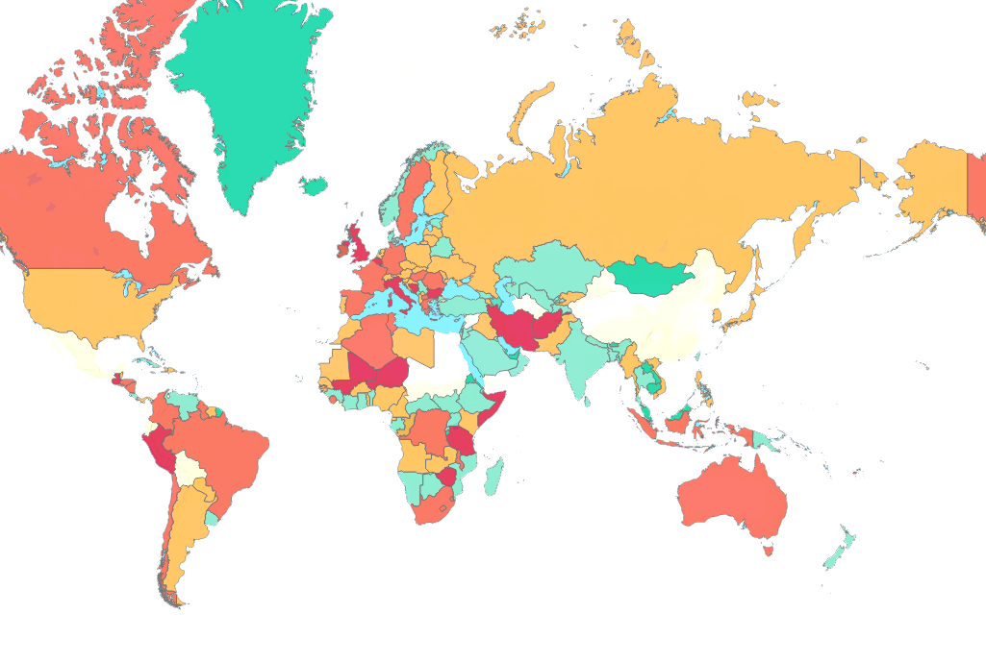
Death Percentage Countries VS Population
Red Color represent the Worst Death percentage in Globally
Green Color refer the less deaths against population.
Red color Countries has most death percentage

Slide 11
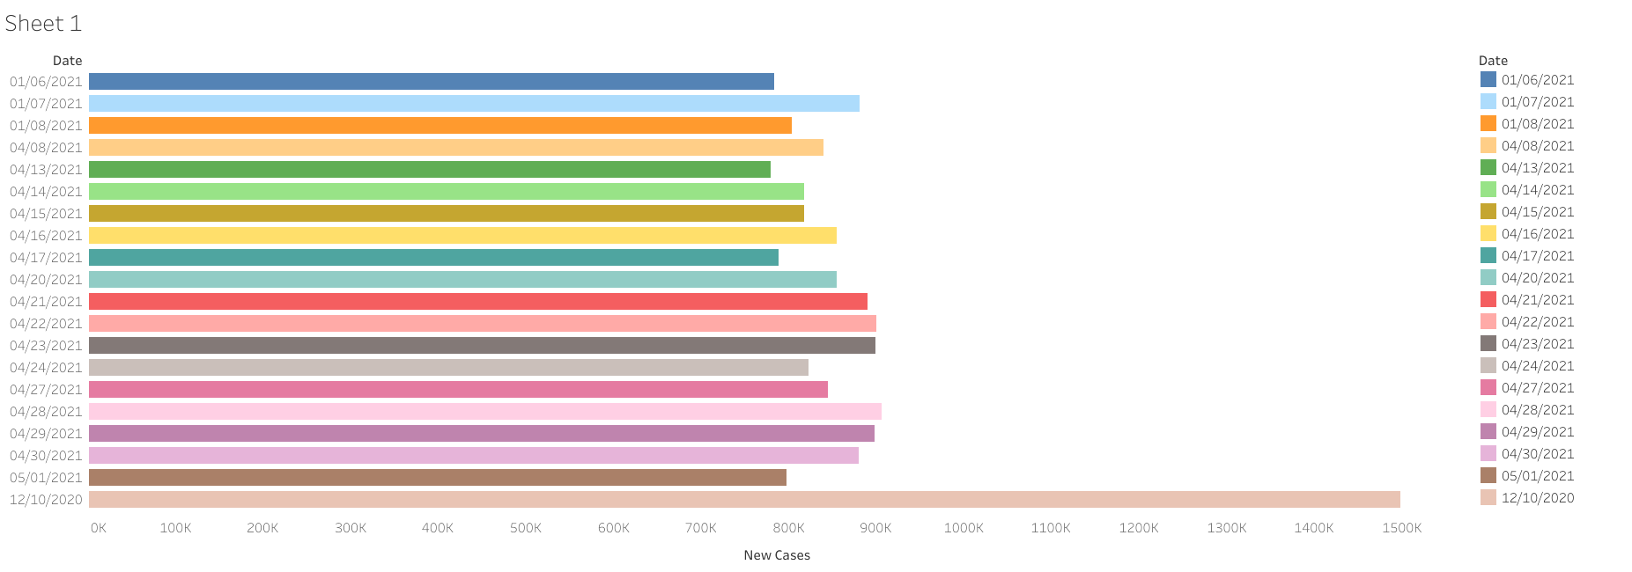
Highest Confirmed Cases Days
This Query show Dates which has Confirmed Highest Cases between 2020-2021.
It's clearly showing 99 percentage of days are in 2021.

Slide 12
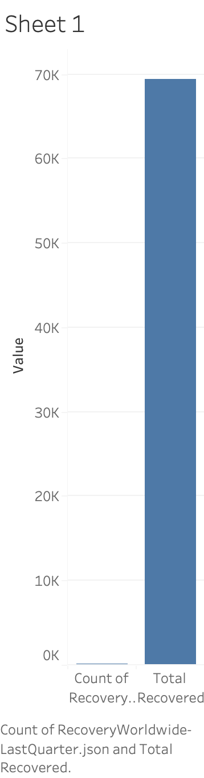
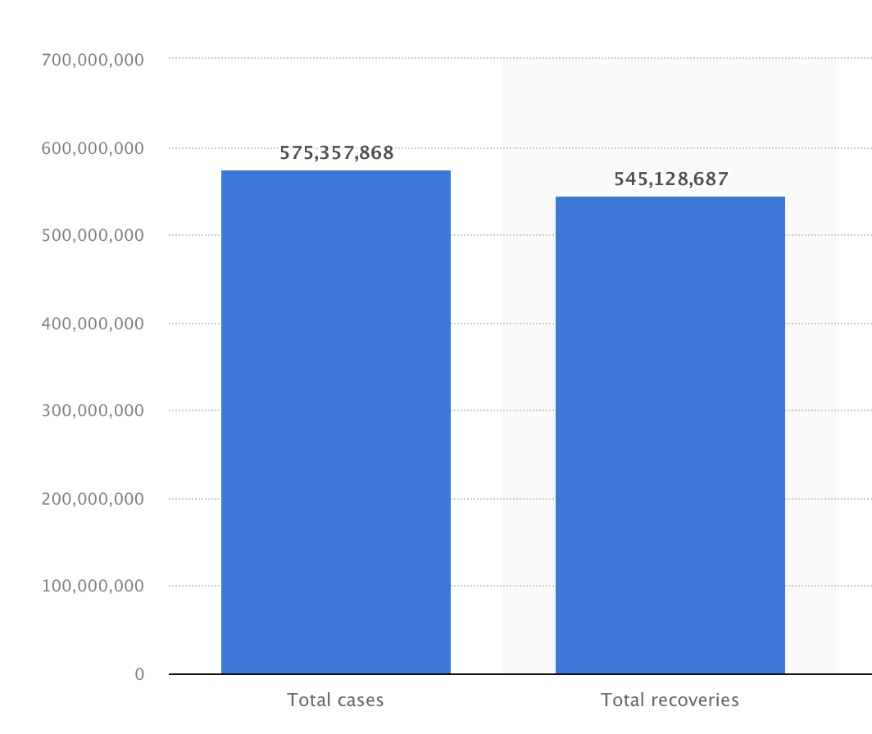
People Recovered In Last Quarter 2020

Slide 13
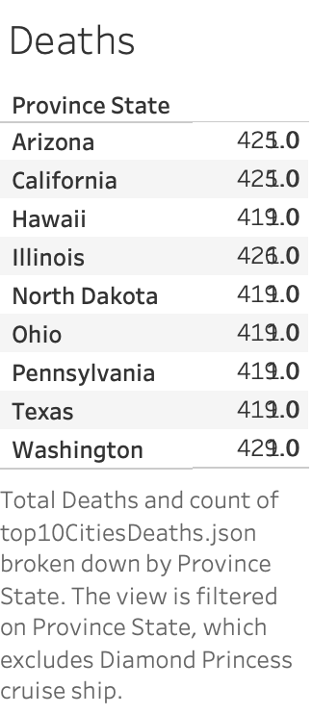
Top 10 States With Highest Deaths in US
1,026,951
deaths
have been reported in the U.S.

Slide 14
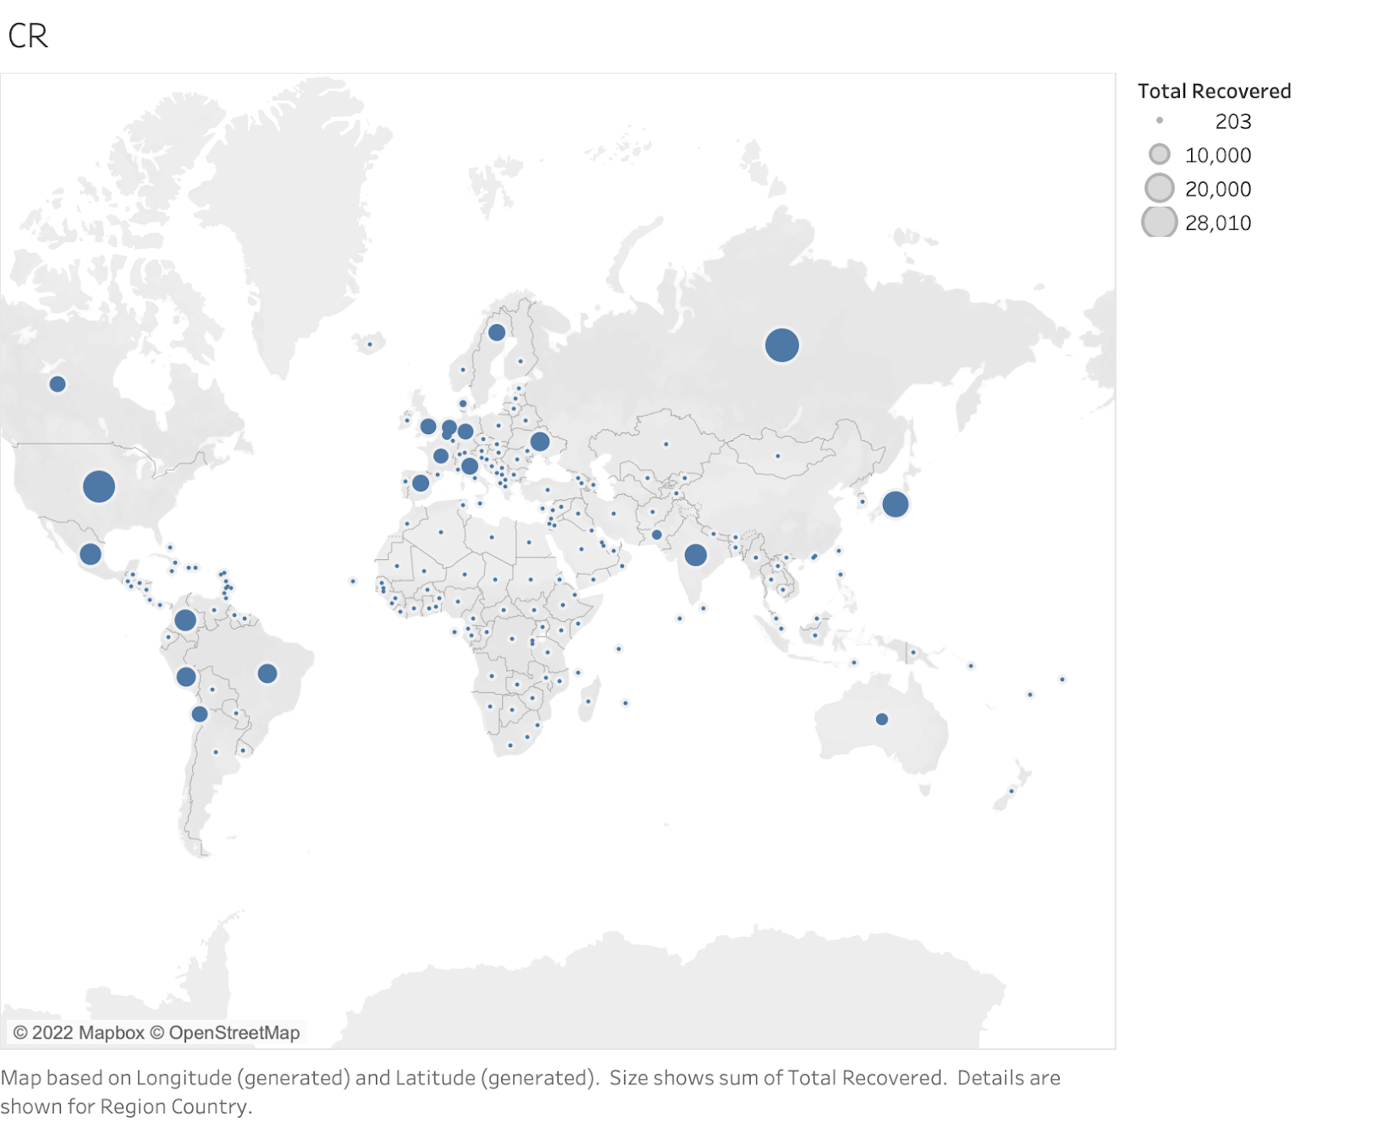
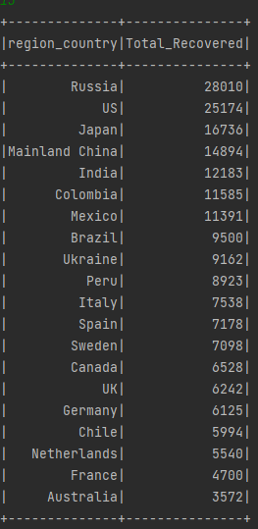
Countries With Most Recovered Cases During Pandemic

Slide 15

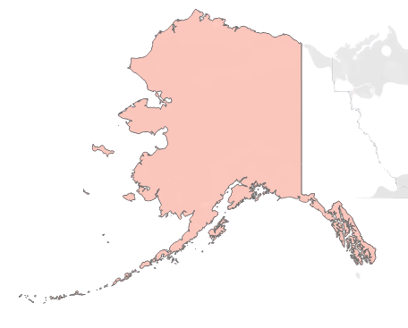
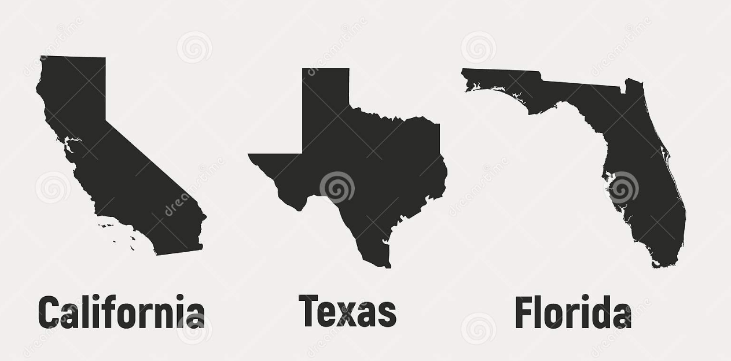
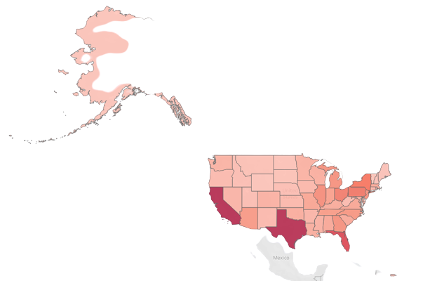
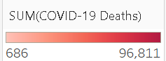
Total Covid Deaths
01/01/20 - 06/30/22
Total Covid Deaths: 1,019,937
California: 96,811
Texas : 96,062
Florida: 71,648

Slide 16

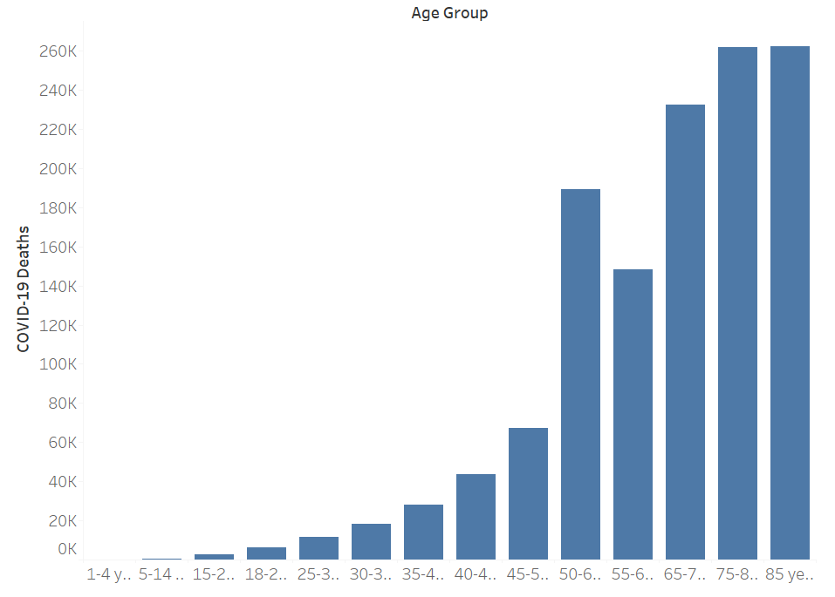
Covid with Age Risk
The risk increases for people in their 50s
and increases in 60s, 70s, and 80s.
People 85 and older are the most likely
to get very sick.

Slide 17
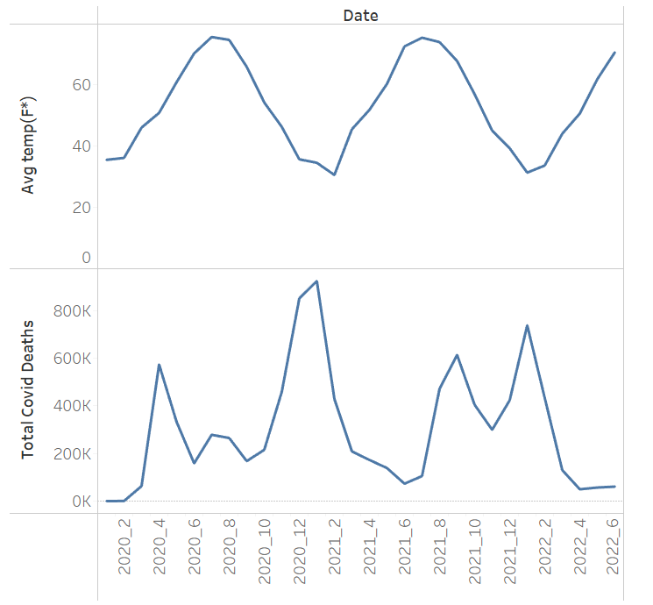

Relation between Death and Temp
The virus is more active at lower temperatures.
Evidence shows that the deaths have a pattern
with temperature
https://public.tableau.com/app/profile/ogarcia2834/viz/COVID-19HumanResources_16587924230720/COVID-19HRDashboard?publish=yes

Slide 18
Query: Show the total covid confirmed data for top 20 cities
code :
val fin = session.spark.sql(“SELECT Admin2 AS City, Province_State AS State, SUM(`5/2/21`) AS Total_Confirmed FROM CovConUS GROUP BY City, State ORDER BY Total_Confirmed DESC”).toDF()

Slide 19
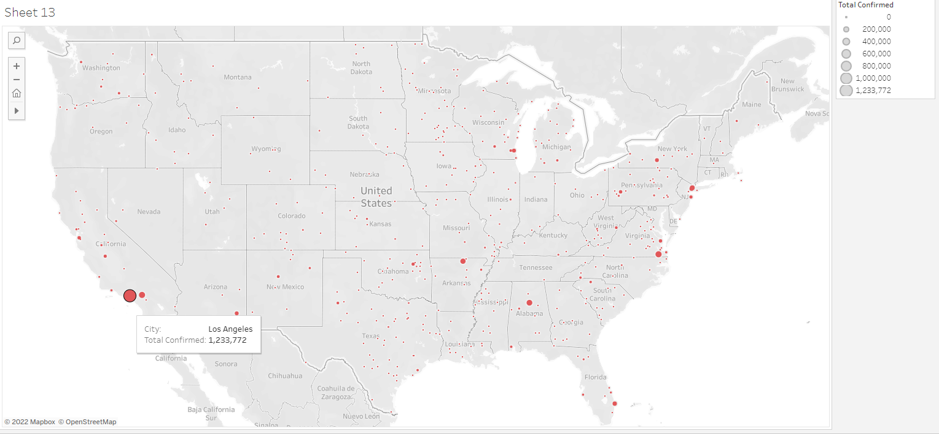
Visualization:

Slide 20
Query: Show top 20 highest covid confirmed percentage from state’s total population
code:
val fin = session.spark.sql(“SELECT c.Province_State AS State, Round(SUM(c.`5/2/21`)*100/SUM(d.Population), 2) AS Covid_Confirmed_Percent FROM CovConUS c JOIN CovDeathUS d ON c.UID = d.UID GROUP BY State ORDER BY Covid_Confirmed_Percent DESC”).toDF()

Slide 21
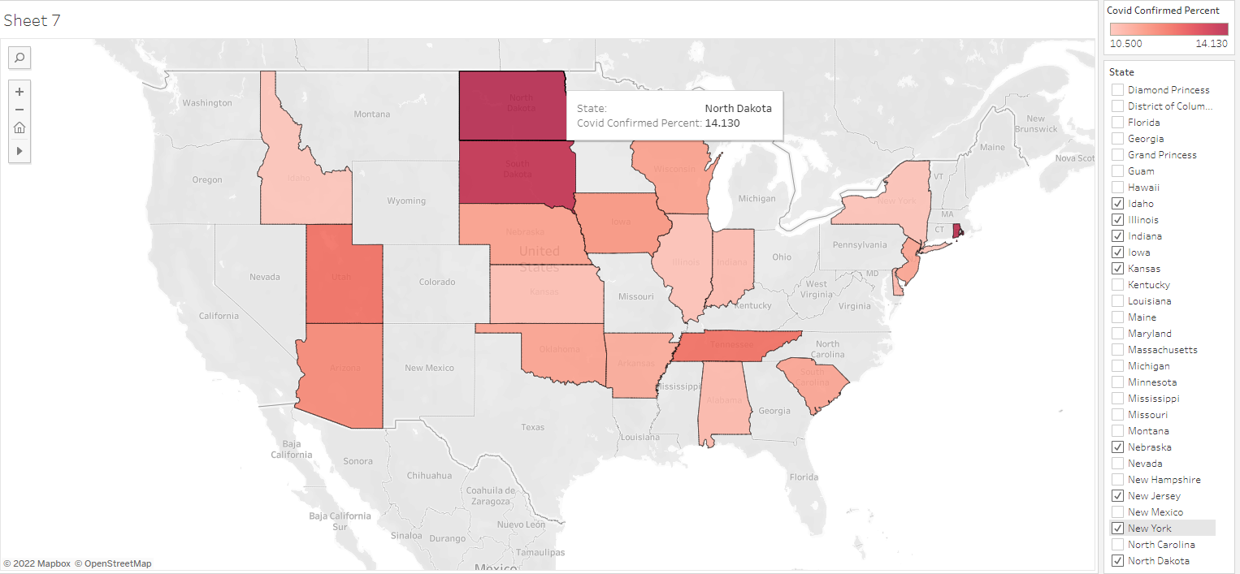
Visualization:

Slide 22
Query: Show the top 20 states with the highest case fatality rate
code:
//formula for case fatality rate = (total # death/total # confirmed) * 100
val fin = session.spark.sql(“SELECT d.Province_State AS State, ROUND((SUM(d.`5/2/21`)/SUM(c.`5/2/21`)*100),2) AS Case_Fatality_Rate FROM CovDeathUS d JOIN CovConUS c ON d.UID = c.UID GROUP BY State ORDER BY Case_Fatality_Rate DESC”).toDF()

Slide 23
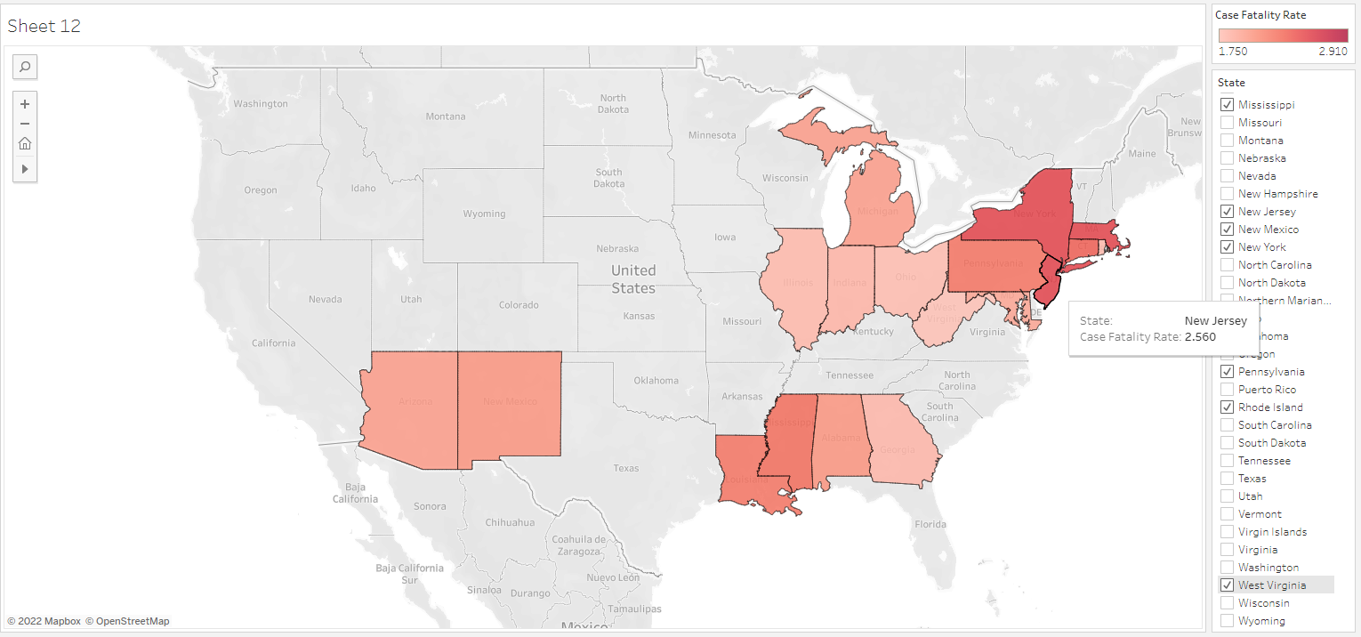
Visualization:

Slide 24
Query: Show the top 20 states with the lowest case fatality rate
Code:
//formula for case fatality rate = (total # death/total # confirmed) * 100
val fin = session.spark.sql(“SELECT d.Province_State AS State, ROUND((SUM(d.`5/2/21`)/SUM(c.`5/2/21`)*100),2) AS Case_Fatality_Rate FROM CovDeathUS d JOIN CovConUS c ON d.UID = c.UID GROUP BY State ORDER BY Case_Fatality_Rate”).toDF()

Slide 25
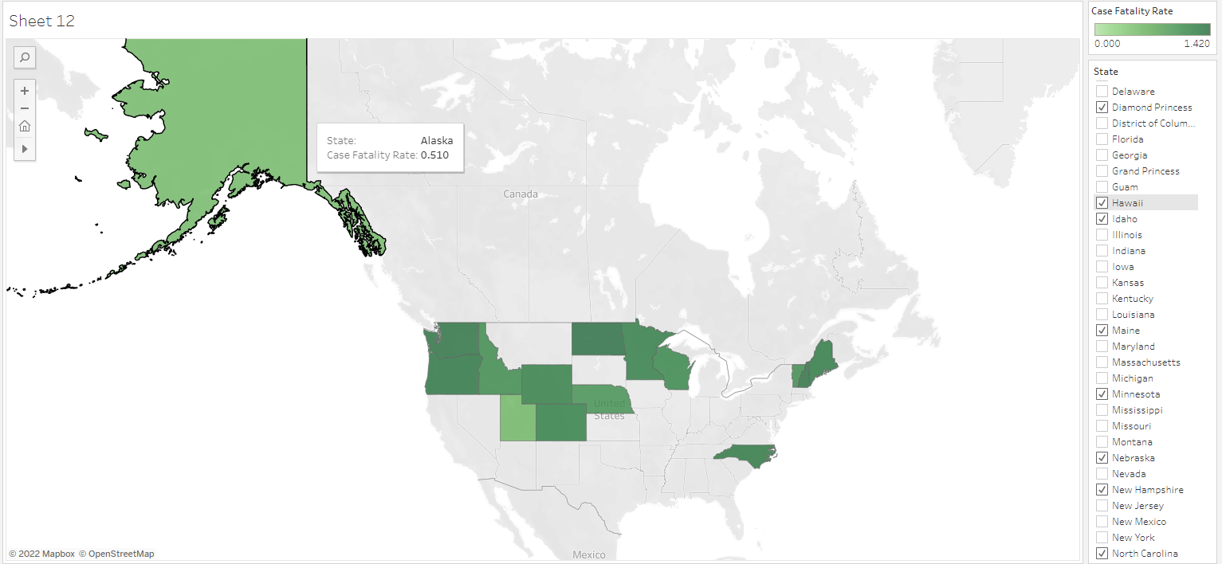
Visualization:

Slide 26
Additional Sources
https://www.businessinsider.com/the-most-popular-us-states-for-tourism-2014-10
https://www.lcrcapital.com/blog/states-most-fortune-500-hqs/
https://media.hopper.com/research/which-states-are-most-likely-to-travel-abroad-this-year
https://jobandwork.asia/databases/
https://worldpopulationreview.com/states

